Slide 1
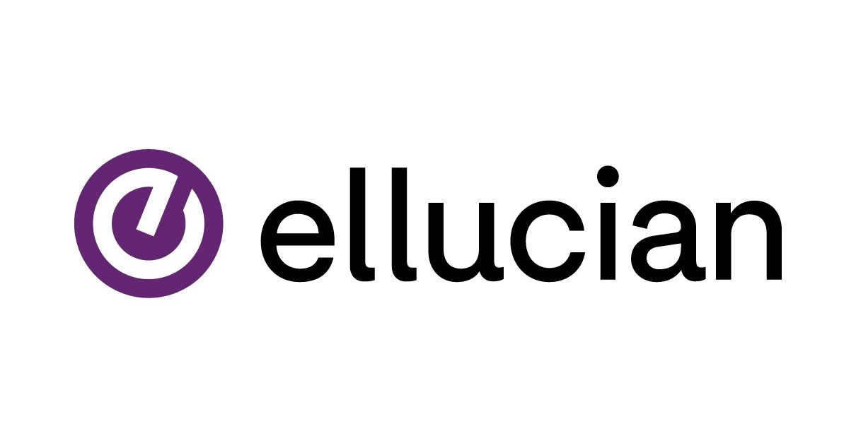
Ellucian Ethos

Slide 2
Agenda
Introduction
What is Ellucian Ethos?
Why Ethos? Point-to-Point vs. Ethos Integration
Ethos Integration Architecture
Ethos Data Model (EEDM)
Messaging Patterns
Ethos Identity Federation Service (EIFS)
Ethos User Provisioning (EUP)
Ethos Data Access
Ethos Extend
Managing Applications in Ethos
Multi-Owner Support
API Keys and Security
Practical Example – Campus Card System
Conclusion

Slide 3
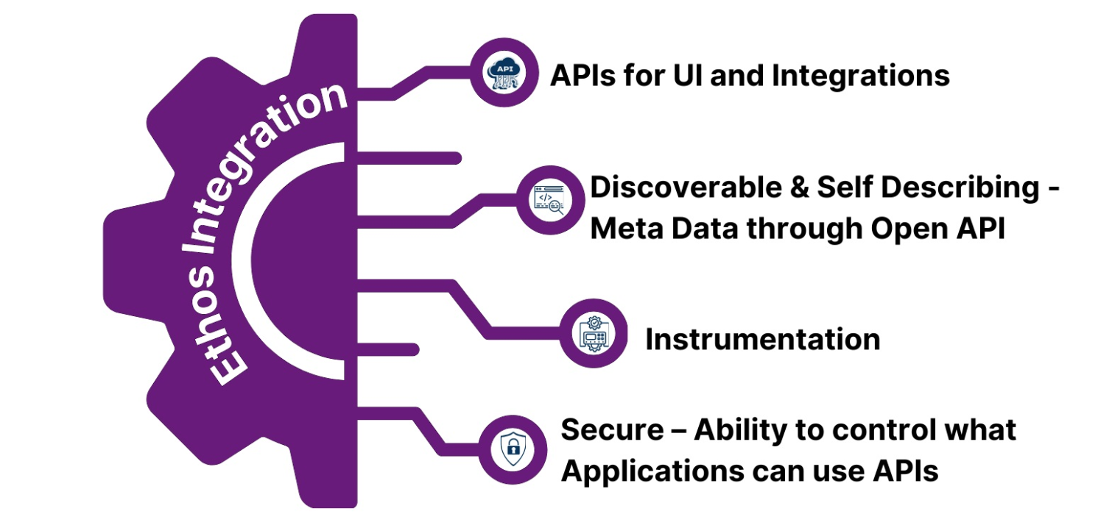
Introduction to Ellucian Ethos Integration
Unifying Data and Applications in Higher Education
Presented by: Pooja Chaudhari & Saksham Dubey
Date: July 16, 2025

Slide 4
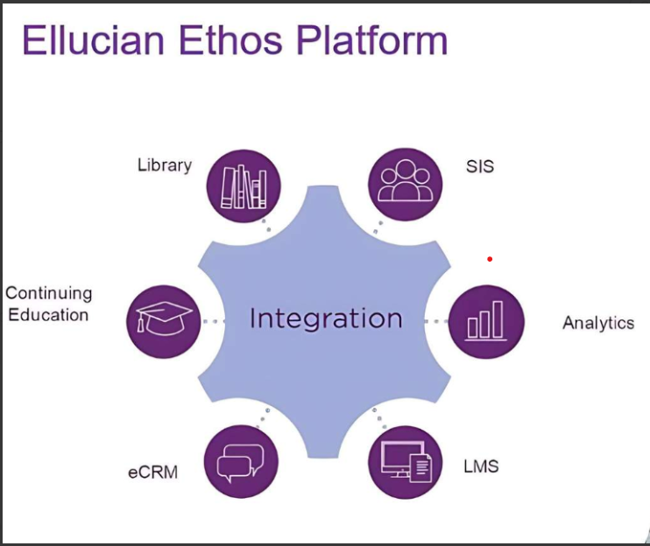
What is Ellucian Ethos?
Ellucian Ethos is a suite of cloud-based products that simplify data integration across campus systems, providing a unified platform for seamless data flow and interoperability.
Key Components:
Ethos Integration (EI): Acts as a central hub that connects and manages data flow between applications.
Ethos Data Model (EEDM): A standardized data structure that ensures consistency and shared understanding across systems.
Ethos Extend: Enables customization of data models without affecting the core schema.
Ethos Data Access: Offers secure, cloud-based access to institutional data through APIs and services.

Slide 5
Why Ethos? Point-to-Point vs. Ethos Integration
Aspect | Point-to-Point (P2P) | Ethos Integration (Hub Model)
Architecture | Direct connections between systems | Single connection to a central hub
Scalability | Poor — connections grow rapidly | Excellent — add one system with one connection
Example | 10 systems = 45 individual connections | 10 systems = 10 hub connections
Maintenance | High — changes affect multiple connections | Low — changes isolated through the hub
Cost & Effort | Expensive and complex | Simpler and cheaper
Risk | Fragile — tightly coupled systems | Robust — loosely coupled through the hub

Slide 6
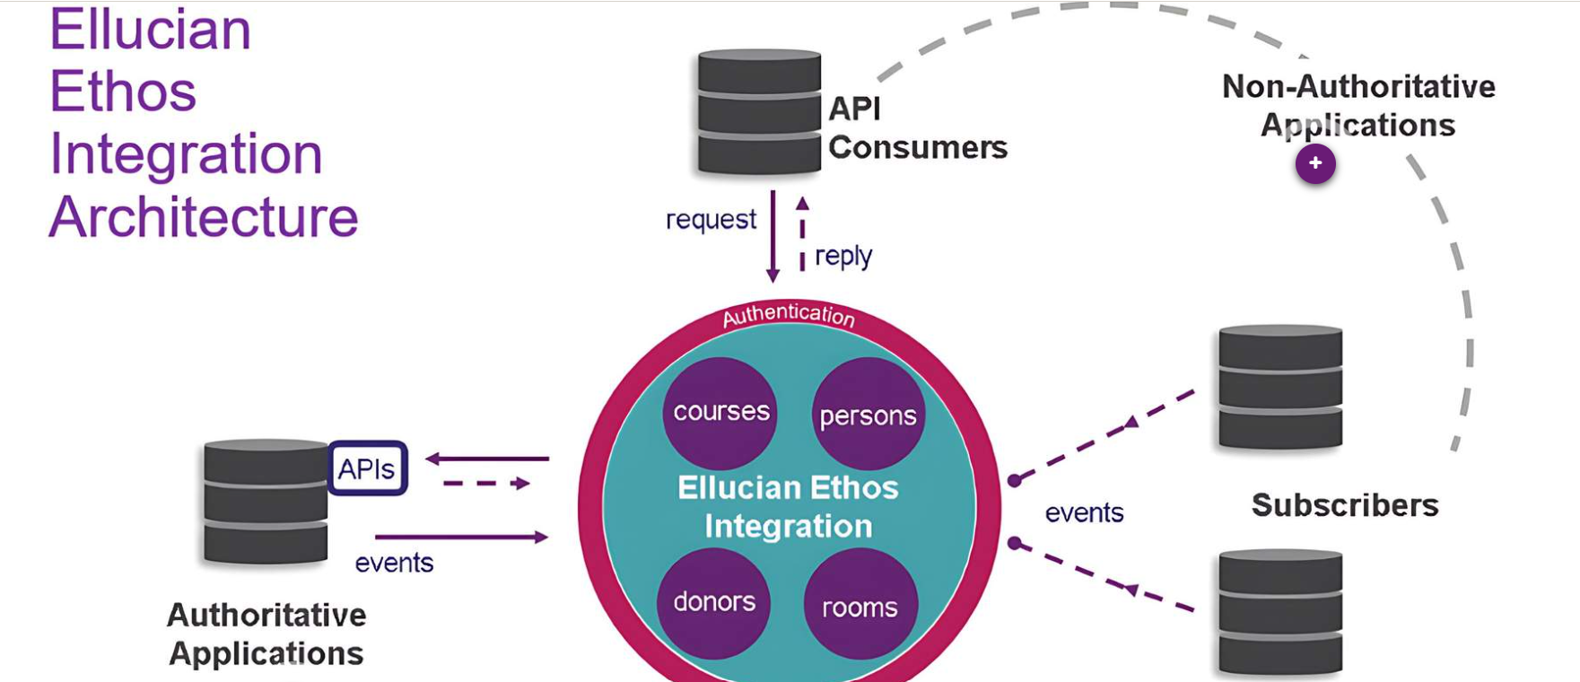
Ethos Integration Architecture
Authoritative Application: Owns and publishes data (e.g., Banner, Colleague)
Ethos Hub: Routes data via REST APIs and message queues
Non-Authoritative (Subscribing) Application: Consumes data through notifications or API calls (e.g., LMS, Bookstore)

Slide 7
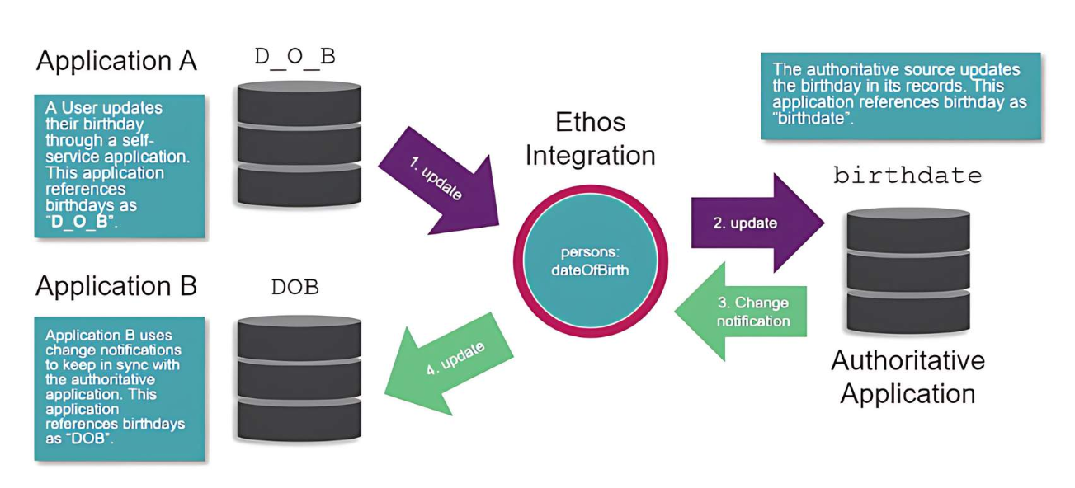
Ethos Data Model (EEDM)
Common Language: Standard terms shared across all institutions
Single Source of Truth: Unified student record accessible to all departments
Open Platform: Community-driven, built on open standards
Extensible: Easily customizable without altering core systems

Slide 8
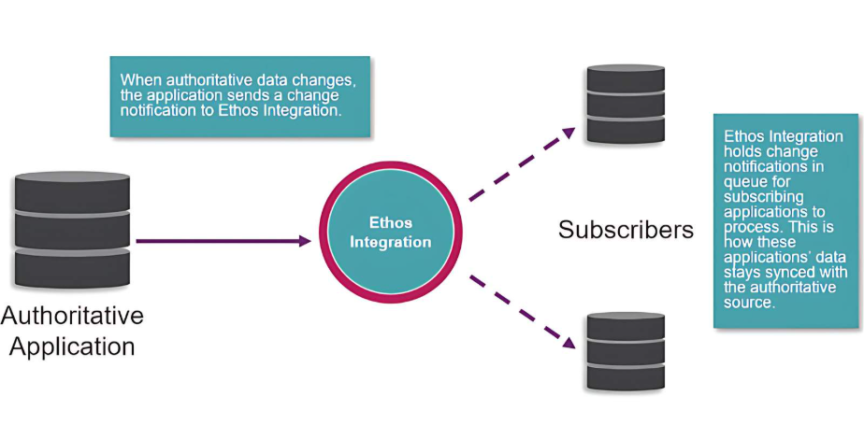
Messaging Patterns
Publish/Subscribe (Async)
Event-based messaging
Systems publish events, others subscribe to receive
Example: Banner publishes new course info → Bookstore receives update

Slide 9
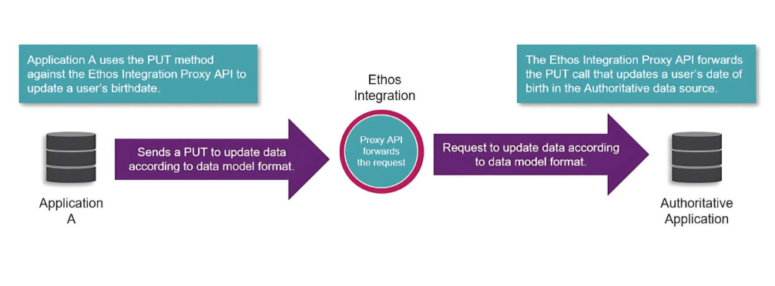
Messaging Patterns
Request/Reply (Sync)
Real-time API request/response
Caller system waits for a reply
Example: Elevate sends course creation request via Ethos Proxy API

Slide 10
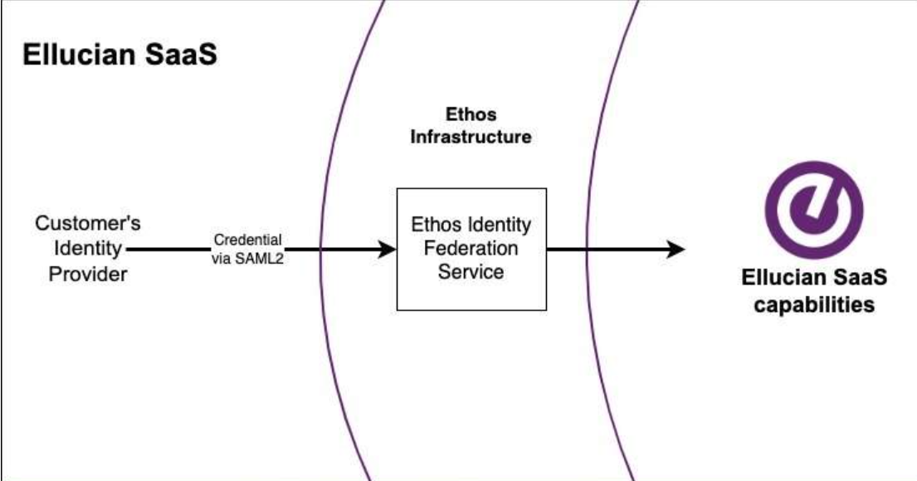
Ethos Identity Federation Service (EIFS)
Ethos Identity Federation Service (EIFS) is a cloud-based Single Sign-On (SSO) solution that enables secure, unified access to all Ellucian applications using modern identity standards.
Key Features:
Uses SAML 2.0 protocol for authentication
Connects to institutional Identity Providers (IdPs) (e.g., Azure AD, Okta)
Acts as a trusted gateway between users and apps
Benefits:
One login for all Ellucian applications (Banner, Colleague, etc.)
Supports multi-tenant and cloud-native environments
Reduces IT overhead by eliminating the need for local identity services
Replaces legacy EEID (Ellucian Enterprise Identity) system

Slide 11
Ethos User Provisioning (EUP)
Ethos User Provisioning (EUP) is a cloud-based service that connects ERPs like Banner/Colleague to Identity Providers (IdPs) such as Azure AD, Okta, or LDAP.
Key Functions:
Automates user account provisioning
Syncs data in bulk or real-time
Keeps Identity Providers updated with user roles, credentials, and statuses
flowchart:
ERP (Banner/Colleague) → EUP → Identity Provider (Azure AD, Okta)

Slide 12
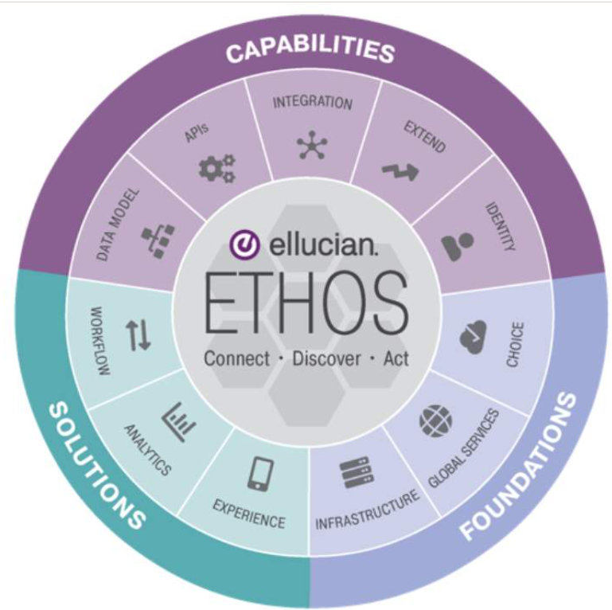
Ethos Data Access
Ethos Data Access provides centralized, cloud-based storage of institutional data from multiple tenants. It ensures real-time data sync, scalability, and fast access for apps and reports.
Key Features:
Cloud storage for data from ERPs (e.g., Banner, Colleague)
Supports:
Initial data loads
Real-time change notifications
Full reloads after major system updates
Uses GraphQL for efficient, flexible data querying
Example Use Cases:
A report pulls real-time student data from Ethos via GraphQL
A third-party app queries updated course or enrollment data
instantly
A department reloads all program data after a system migration

Slide 13
Ethos Extend
Ethos Extend allows institutions to customize data models without altering the core Ethos Data Model — offering flexibility without sacrificing standards
Capabilities:
Add custom fields to existing models
- Example: Add “preferredPronouns” to the Person model
Create entirely new models
- Example: Define a new Parking Permit model
All extensions are accessible via GraphQL APIs
Changes are non-destructive and safe across systems

Slide 14
Managing Applications in Ethos
The Ethos Integration dashboard allows administrators to manage, configure, and monitor institutional applications connected to the Ethos hub.
Key Tabs & Their Functions:
API Keys:
Used to authenticate applications securely
Includes options for restricted and unrestricted access
Owned Resources:
Specifies what data an app is authoritative for
Ensures consistent ownership and data flow control
Resource Subscriptions:
Define which apps subscribe to changes in specific resources
Supports Publish/Subscribe messaging
Monitoring Dashboard:
Tracks app activity, connection status, and recent data events
Helps with troubleshooting and performance monitoring

Slide 15
Multi-Owner Support
Ethos allows multiple applications to be marked as owners of the same resource type. This provides flexibility and isolation in multi-vendor or multi-campus environments.
Common Use Cases:
Multiple Campus Instances
- (e.g., Campus A and Campus B each manage their own email-types)
Multiple Vendors
- (e.g., Two different apps updating phone-types independently)
Banner Multi-Entity Processing (MEP)
- Allows multiple entities (schools, departments) to share one ERP system
- Each entity acts as a separate owner for its own data

Slide 16
API Keys and Security
Types of API Keys:
Unrestricted: Broad access, flexible for most integrations
Restricted: Tied to specific IP addresses for enhanced security
Authentication Flow:
Application sends API Key to Ethos
Ethos returns a JWT (JSON Web Token)
JWT is used to authenticate subsequent API calls

Slide 17
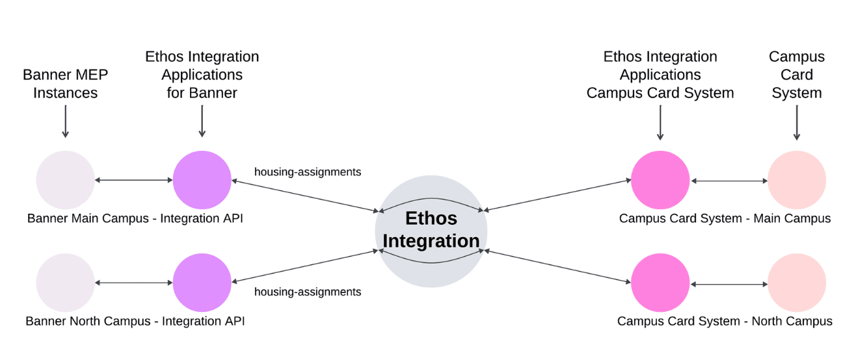
Practical Example – Campus Card System
A Campus Card System needs to integrate with Banner MEP (Multi-Entity Processing) to manage services like housing, dining, and access control across multiple campuses.
Integration Models:
1. One-to-One Integration
- Each campus card system connects directly to its own Banner instance
- Ideal for independent campuses with separate data ownership

Slide 18
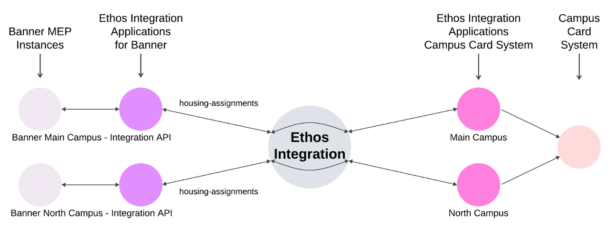
Practical Example – Campus Card System
2. Many-to-One Integration
- A central card system connects to multiple Banner instances
- Requires Ethos to manage routing and isolation
Ethos Benefits:
Supports multi-entity routing using ownership context
Maintains data separation between campuses
Allows flexible integration, regardless of system architecture

Slide 19
Conclusion
Key Takeaways:
Centralized Hub: Ethos simplifies system integrations by replacing point-to-point connections with a unified hub.
Standardized Data Model: Promotes consistency and clarity across apps using EEDM.
Secure & Scalable: Supports Single Sign-On (EIFS), user provisioning (EUP), and multi-campus environments.
Customizable: Easily extended with Ethos Extend — no need to modify core systems.
Helpful Resources:
🔗 github.com/ellucianEthos
🔗 elluciancloud.com

Slide 20
Thank you

